Slide 1
Lecture-9
Virtual Memory
(VM, Demand Paging, Page Fault)

Slide 2
Virtual Memory
Virtual memory – separation of user logical memory from physical memory.
Only part of the program needs to be in memory for execution
Logical address space can therefore be much larger than physical address space
Allows for more efficient process creation
Virtual memory can be implemented via:
Demand paging
Demand segmentation

Slide 3
Virtual Memory Diagram
virtual memory
page 0
page 1
page 2
page 3
secondary storage
memory map
physical memory
page n
Fig. 9.1, p.291

Slide 4
What is VM?
Program:
....
Mov AX, 0xA0F4
....
Table
(one per
Process)
0xA0F4
Mapping
Unit
(MMU)
0xC0F4
Virtual
Address
„Piece“ of Virtual Memory
Physical Memory
„Piece“ of Physical Memory
Physical
Address
Virtual Memory
Link
Notes:
4
Not only address to address mapping, but piece to piece
VAS usually much larger than PAS

Slide 5
Why Virtual Memory (VM)
Shortage of memory
Efficient memory management needed
Process may be too big for physical memory
More active processes than physical memory can hold
Requirements of multiprogramming
Efficient protection scheme
Simple way of sharing
Process 3
Process 2
Process 4
Process 1
OS
Memory
Notes:
5
Mention external fragmentation

Slide 6
The Mapping Process
Usually every process has its own mapping table
Not every „piece“ of VM has to be present in PM
„Pieces“ may be loaded from HDD as they are referenced
Rarely used „pieces“ may be discarded or written out to disk (→ swapping)
check using mapping table
piece
in physical
memory?
OS brings
„piece“ in
from HDD
virtual
address
memory
access fault
yes
OS adjusts
mapping
table
physical
address
translate
address
MMU

Slide 7
Demand Paging
Bring a page into memory only when it is needed
Less I/O needed
Less memory needed
Faster response
More users
Page is needed ⇒ reference to it
invalid reference ⇒ abort
not-in-memory ⇒ bring to memory

Slide 8
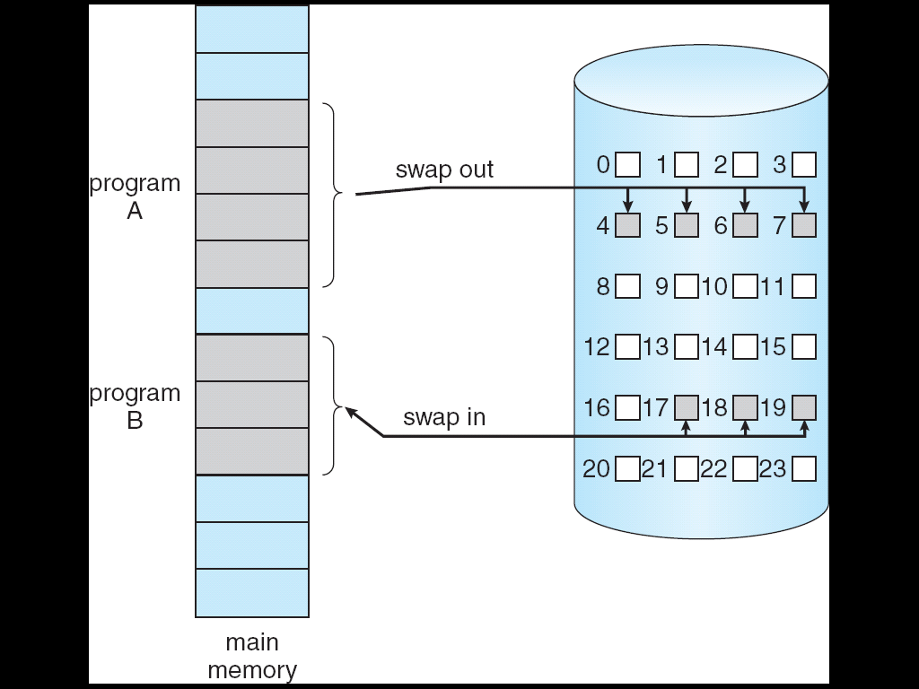
Transfer of a Paged Memory to Contiguous Disk Space

Slide 9
Transfer of a Paged Memory to Contiguous Disk Space
To replace pages or segments of data in memory. Swapping is a useful technique that enables a computer to execute programs and manipulate data files larger than main memory. When the operating system needs data from the disk, it exchanges a portion of data (called a page or segment ) in main memory with a portion of data on the disk.
DOS does not perform swapping, but most other operating systems, including OS/2, Windows, and UNIX, do. Swapping is often called paging.
When set of paged data sets moved from auxiliary storage to real storage during execution of any job is called swap-in. Reverse is swap out.

Slide 10
What is a process
We typically mean that a process is a running program
A better definition is that a process is the state of a running program
Now we have a really good definition of the state of a running program
A program counter
A page table
Register values

Slide 11
Address Translation
Physical Memory
CPU
A.1
@8190
B.1
C.1
A.2
virtual
addresses
0-4095
4096-8191
8192-12287
12288-16384
C.4
address
translation
C.6
Process A
B.2
A.1
B.3
A.2
A.3
A.4
A.3
A.4
C.2
Disk
C.3
C.5
. . .
. . .
Link

Slide 12
Example
Physical Memory
Process A
A.1
A.2
A.3
A.4
Process B
B.1
B.2
B.3
Process C
C.1
C.2
Disk
C.3
C.4
C.5
C.6

Slide 13
Example: Memory Snapshot
Physical Memory
Process A
A.1
A.1
A.2
B.1
A.3
C.1
A.4
A.3
C.4
C.6
Process B
B.2
B.1
B.3
B.2
B.3
Process C
A.2
A.4
C.1
C.2
Disk
C.2
C.3
C.3
C.5
C.4
. . .
C.5
. . .
C.6

Slide 14
Memory Protection
Process A
Physical Memory
A.1
A.2
A.1
A.3
B.1
A.4
C.1
A.3
Process B
C.4
B.1
C.6
B.2
B.2
B.3
B.3
Process C
C.1
A.2
C.2
A.4
C.3
C.2
Disk
C.4
C.3
C.5
C.5
C.6
. . .
. . .
Virtual memory ensures protection
Process A cannot read/write into the memory of process B
As we’re going to see, this is easily enforced by the virtual memory address translation scheme

Slide 15
Paging
Each process has its own page table
Each page table entry contains the frame number of the corresponding page in main memory
A bit is needed to indicate whether the page is in main memory or not

Slide 16
Page Tables
The entire page table may take up too much main memory
Page tables are also stored in virtual memory
When a process is running, part of its page table is in main memory

Slide 17
Page Size
Smaller page size, less amount of internal fragmentation
Smaller page size, more pages required per process
More pages per process means larger page tables
Larger page tables means large portion of page tables in virtual memory

Slide 18
Page Faults
A miss in the page table is called a page fault
When the “valid” bit is not set to 1, then the page must be brought in from disk, possibly replacing another page in memory

Slide 19
VM:Sharing
Pieces of different processes mapped to one single piece of physical memory
Link
Piece 0
Piece 0
Piece 0
Piece 1
Piece 1
Piece 1
Piece 2
Piece 2
Piece 2
Physical
memory
shared
memory
Virtual memory
Process 1
Virtual memory
Process 2
19
Notes:
19
Shared Code must be reentrant (non-self-modifying)

Slide 20
VM: Advantages
VM supports
Swapping
Rarely used „pieces“ can be discarded or swapped out
„Piece“ can be swapped back in to any free piece of physical memory large enough, mapping unit translates addresses
Protection
Sharing
Common data or code may be shared to save memory
Code can be placed anywhere in physical memory without relocation (adresses are mapped!)

Slide 21
VM: Disadvantages
Memory requirements (mapping tables)
Longer memory access times (mapping table lookup)
Notes:
21

Slide 22
That’s All Thank You

